Slide 1
Everything You Need to Know About Genetic Defects (For Now)
Dr. John B. Cole
Department of Animal Science, Michigan State University | April 8, 2025

Slide 2
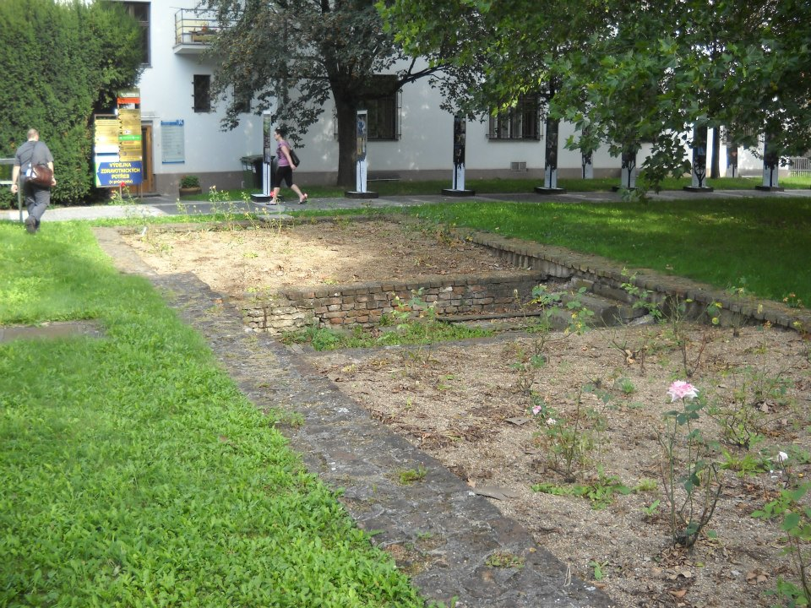
Overview
What are genetic disorders, and how do we find them?
Validation of causal variants
Population management
Inbreeding and recessive loci
Discussion

Slide 3
What are genetic defects, and where do they come from?

Slide 4
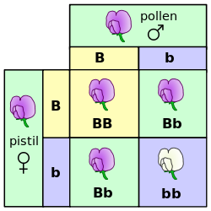
Mendelian traits
One locus, typically with two alleles
Often exhibit complete dominance
Autosomal recessive
Many loci in cattle (Cole et al., 2018)
Autosomal dominant
Polled (Medugorac et al., 2011), MITF (Philipp et al., 2011)
Source: https://commons.wikimedia.org/wiki/File:Punnett_square_mendel_flowers.svg.

Slide 5
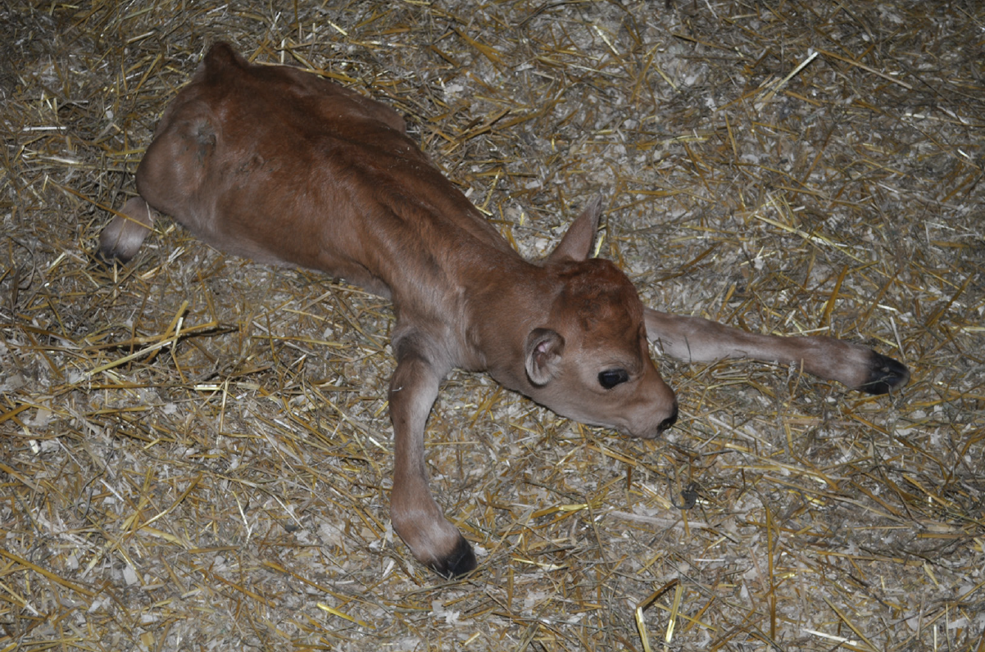
Genetic defects
Presentation varies widely, from gross congenital malformation to subtle physiological differences
The worst defects result in the birth of lives calves which must be euthanized
May result from large or small changes in DNA
A Jersey calf homozygous for neuropathy with splayed forelimbs (American Jersey Cattle Association, Reynoldsburg, OH).

Slide 6
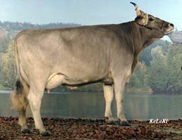
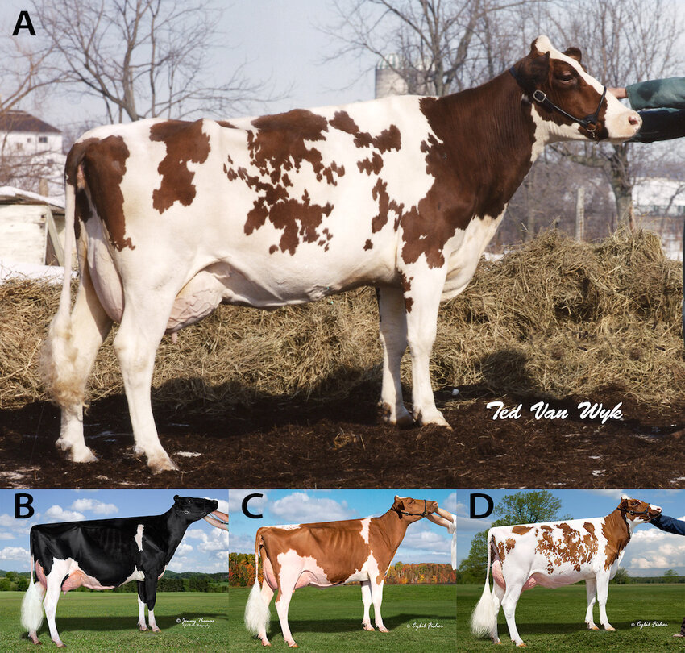
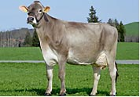
Physical characteristics
Horned
Red Coat Color
Polled
The Brown Swiss Cattle Breeders Association of New Zealand, Inc.
Dorshorst et al. (2015)

Slide 7

There are many known genetic defects
There are 698 genetic traits/disorders of cattle in the “Online Mendelian Inheritance in Animals” database (03/30/2025)
https://omia.org/home/
273 of these are Mendelian traits/disorders

Slide 8
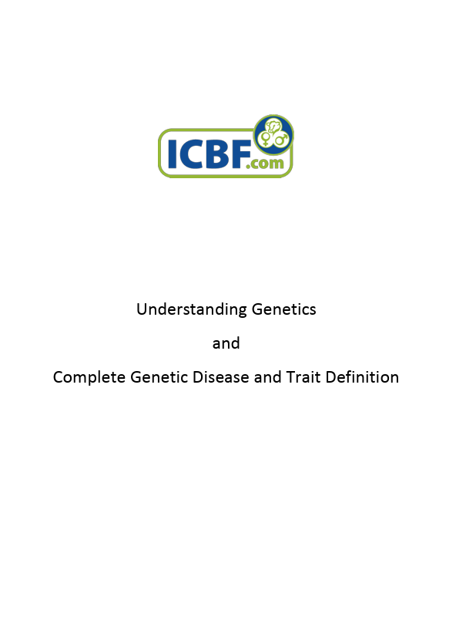
How do we learn about these defects?
Defects which affect calf health or morphology are usually reported by farmers, veterinarians, or AI staff.
Fertility haplotypes are detected using genomic data (VanRaden et al., 2011).
Sequence data are now being used to identify cryptic defects (e.g., Besnard et a., 2024).
McClure & McClure, (2016) https://www.icbf.com/wp-content/uploads/2014/06/Extended-Disease-Trait-Definitions.pdf

Slide 9
Crossovers physically rearrange DNA
Parental Chromosomes
Some Potential Gametes
Single crossover (one break in each piece of DNA, most common event)
Double crossover (two breaks in each piece of DNA, less-common event)
After Many Generations, All Chromosomes are Patchworks of Ancestral Chromosomes

Slide 10
How do we haplotype animals?
Genotyped Animal’s Chromosomes
SNP 1
SNP 101
SNP 301
…
SNP 2,300
SNP 1
SNP 201
SNP 301
…
SNP 2,300
Pool of 100-SNP Haplotype Blocks
“lost”
“lost”
2
…
2,299
2
…
2,299
1
“lost”
1
“lost”
We Can Fill-in (“Impute”) Missing Blocks from Lower-Density SNP Chips
SNP 1
(missing)
SNP 301
…
SNP 2,300
SNP 1
(missing)
SNP 301
…
SNP 2,300
1
2
1
2

Slide 11
Finding new defects using haplotypes
Haplotype Blocks Seen in the Population
Which haplotypes never appear as homozygotes?
How many do we expect to see given their frequency?
What are their effects on fertility and calving traits?
Automated part of genomic evaluation workflow
There may be a new haplotype!
!

Slide 12
Effects are confirmed using fertility data
Carrier-to- carrier matings are tested for effects on conception rate and stillbirth
Early embryonic losses show conception rate effects (e.g., HH2, JH1)
Some variants show stillbirth effects (e.g., BH2 and HCD)
Bioinformatics used to identify potential causal variants
What about functional validation?

Slide 13
Known recessives in US Holsteins (August 2024)
Defect | OMIA ID | Year | Identifier |  | Gene name |  | Frequency (%) | Chromosome | Location (bp)
Bovine leukocyte adhesion deficiency (BLAD) | 000595 | 1983 | HHB |  | ITGB2 |  | 0.03 | 1 | 144,770,078
Bovine lymphocyte intestinal retention defect (BLIRD) | 002872 | 2023 | — |  | ITGB7 |  | — | 5 | 26,807,079
Brachyspina | 000151 | 2006 | HH0 |  | FANCI |  | 0.28 | 21 | 20,775,563
Cholesterol deficiency | 001965 | 2015 | HCD |  | APOB |  | 0.34 | 11 | 77,872,709
Complex vertebral malformation | 001340 | 2000 | HHC |  | SLC35A3 |  | 0.25 | 3 | 43,261,946
Deficiency of uridine monophposphate synthase (DUMPS) | 000262 | 1983 | HHD |  | UMPS |  | <0.01 | 1 | 69,151,931
Early onset muscle weakness syndrome | 002819 | 2022 | HMW |  | CACNA1S |  | 2.04 | 16 | 79,613,592
Holstein Haplotype 1 | 000001 | 2011 | HH1 |  | APAF1 |  | 0.40 | 5 | 62,810,245
Holstein Haplotype 2 | 001823 | 2011 | HH2 |  | IFT80 |  | 0.68 | 1 | 107,172,615
Holstein Haplotype 3 | 001824 | 2011 | HH3 |  | SMC2 |  | 0.65 | 8 | 93,753,358
Holstein Haplotype 4 | 001826 | 2013 | HH4 |  | GART |  | 0.09 | 1 | 1,997,582
Holstein Haplotype 5 | 001941 | 2013 | HH5 |  | TFB1M |  | 2.50 | 9 | 91,847,117– 91,937,003
Holstein Haplotype 6 | 002149 | 2018 | HH6 |  | SDE2 |  | 1.14 | 16 | 29,773,628
Holstein Haplotype 7 | 001830 | 2020 | — |  | CENPU |  | 0.80 | 27 | 14,168,130–14,168,133
Holstein Haplotype 8 | 001831 | 2013 | — |  | — |  | 2.10 | 7 | 78,800,000–80,100,000
Mulefoot (syndactylism) | 000963 | 1949 | HHM |  | LRP4 |  | <0.01 | 15 | 76,807,960

Slide 14
Timing of recessive effects
Late losses cost more than early lossses (Cole et al., 2016)
A defect may cause deaths in more than one time period
Embryonic loss/abortion | Death at or near birth | Wks/mos following birth
BH1, HH0, HH1, HH2, HH3, HH4, HH5, CVM, JH1, potential new haplotype | BH2, HH0, CVM, syndactyly (mulefoot), neuropathy with splayed forelimbs | AH1, BH2, HH6, BLAD, cholesterol deficiency, early onset muscle weakness, HH6, HH7, spinal dysmyelination, spinal muscular atrophy, weaver syndrome

Slide 15
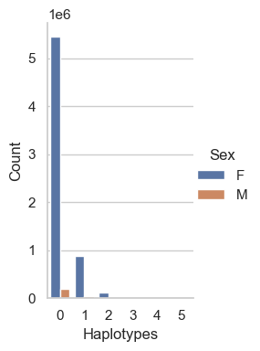
How many defects do individuals carry?
Haplo-types | AY |  | BS |  | HO |  | JE
 | Bulls | Cows | Bulls | Cows | Bulls | Cows | Bulls | Cows
0 | 1,626 | 12,031 | 47,531 | 27,476 | 200,422 | 5,459,679 | 38,649 | 708,497
1 | 1,025 | 5,572 | 6,588 | 4,153 | 33,327 | 877,371 | 9,410 | 141,941
2 | 126 | 657 | 326 | 224 | 4,293 | 120,487 | 542 | 7,881
3 | − | − | 10 | 99 | 187 | 6,427 | − | −
4 | − | − | − | − | 2 | 164 | − | −
5 | − | − | − | − | 0 | 5 | − | −
Council on Dairy Cattle Breeding (April 2025 genetic evaluation run)

Slide 16
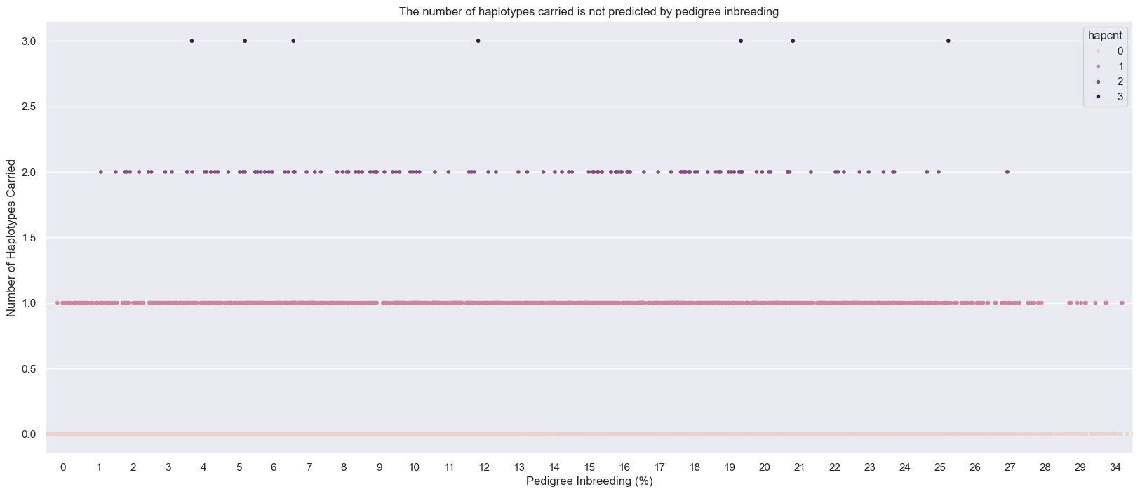
Inbreeding doesn’t predict defects

Slide 17
Estimated economic impact of genetic load
Cole et al. (2016; 2025) estimated annual losses of at least ~$4.1 million due to known recessives, a substantial reduction over the last decade from an earlier estimate of $10.7 million.
Average losses were $4.34, $0.17, $0.32, and $0.81 in Ayrshire, Brown Swiss, Holstein, and Jersey, respectively.
This is the economic impact of genetic load as it affects fertility and perinatal mortality.
Actual losses are likely to be higher.

Slide 18
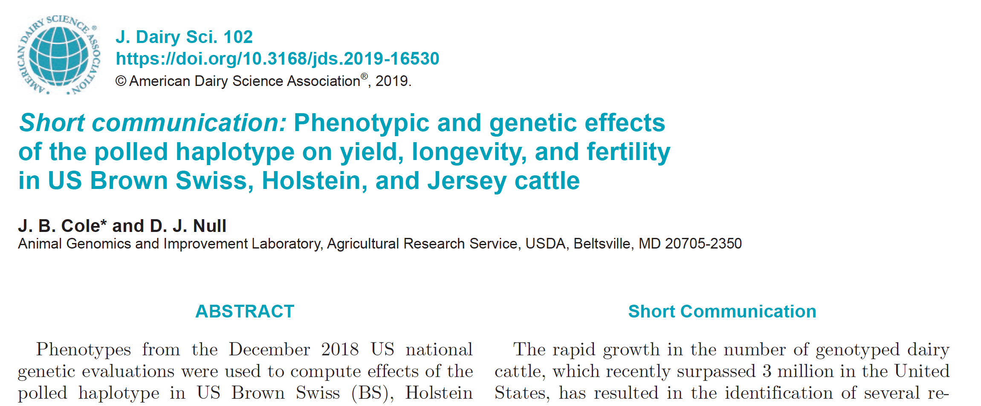
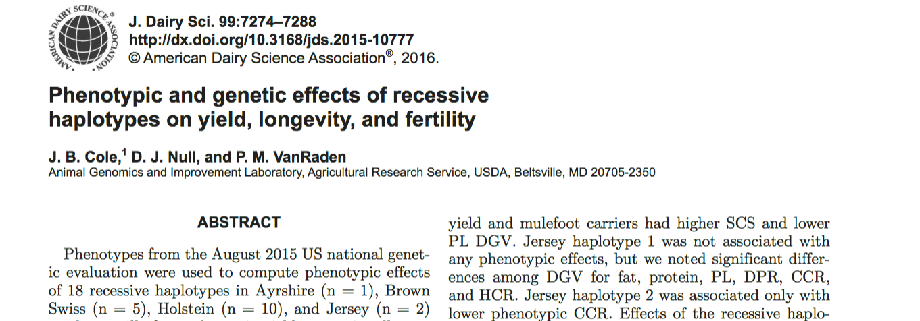
Does pleiotropy affect economic traits?
Effects of recessive haplotypes generally were small even when different from 0

Slide 19
Is the number of defects increasing?
MacArthur et al. (2012) estimated that human genomes contain ~100 loss-of-function mutations, and ~20 completely inactivated genes
The mutations are there even if we have not identified them yet
Example: HH6, mutation in SDE2 (Fritz et al., 2018)
Our detection methods are improving as our technology improves
We continue to make many copies of haplotypes from a small number of bulls, uncovering existing genetic load

Slide 20
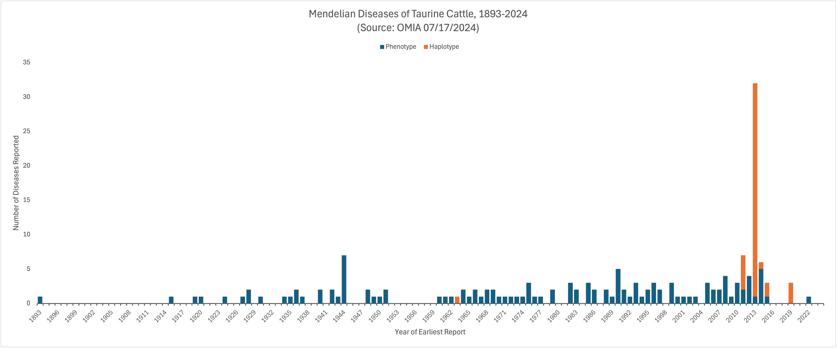
Are defects discovered more frequently today?
Cole et al. (2025)

Slide 21
How do we functionally validate putative causal variants?

Slide 22
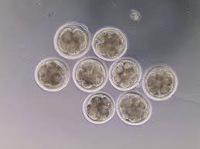
Validation of candidate variants
Candidate genes for early embryonic losses not always validated in the laboratory
Targeted knockouts can be used to validate candidates for early embryonic losses
Relatively fast and cost-effective
Source: University of Florida (2013).

Slide 23
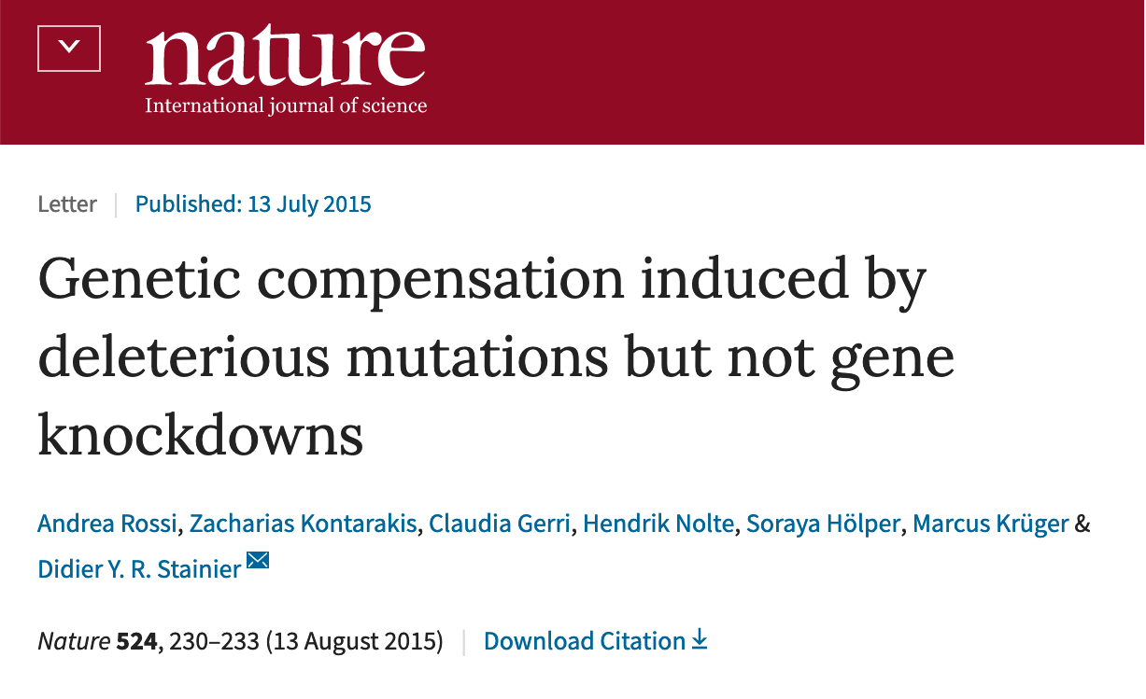
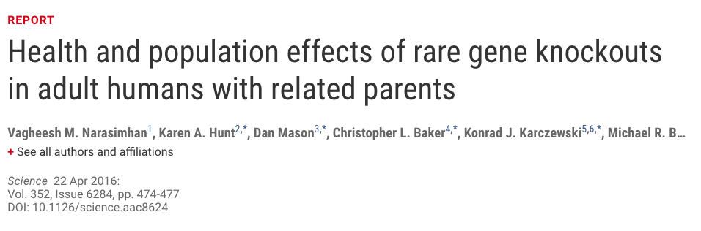
Why is functional validation desirable?
Not all mutations produce phenotypic changes
Compensatory networks can buffer against deleterious mutations (Rossi et al., 2015)
Many homozygous loss-of-function alleles produce no deleterious phenotypes, including some expected to result in genetic disease (Narasimhan et al., 2016)

Slide 24
Identification of a candidate HH2 variant
HH2 identified using a deficiency-of-homozygotes approach and undesirable effects on conception rate and stillbirths confirmed
5 carriers in 183 Holstein bulls selected to maximize coverage of unique haplotypes
3 variants concordant with haplotype calls were found
A high-impact frameshift in intraflagellar protein 80 (IFT80) was confirmed using 1000 Bull Genomes Project data that shared no animals with the discovery set

Slide 25
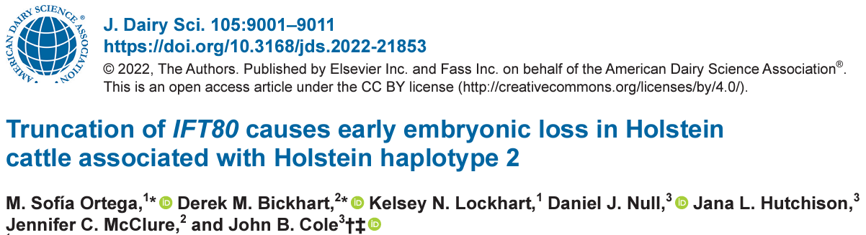
Validation of candidate HH2 variant
IFT80-null embryos generated by truncation at exon 2 with guide-RNAs annealed to Cas9 mRNA
Abattoir-derived oocytes fertilized in vitro with high-fertility semen
Embryos injected at the one-cell stage with CRISPR-Cas9 complex (treatment) or Cas9 mRNA(control) before return to culture
IFT80-null embryos arrested at the 8-cell stage of development

Slide 26
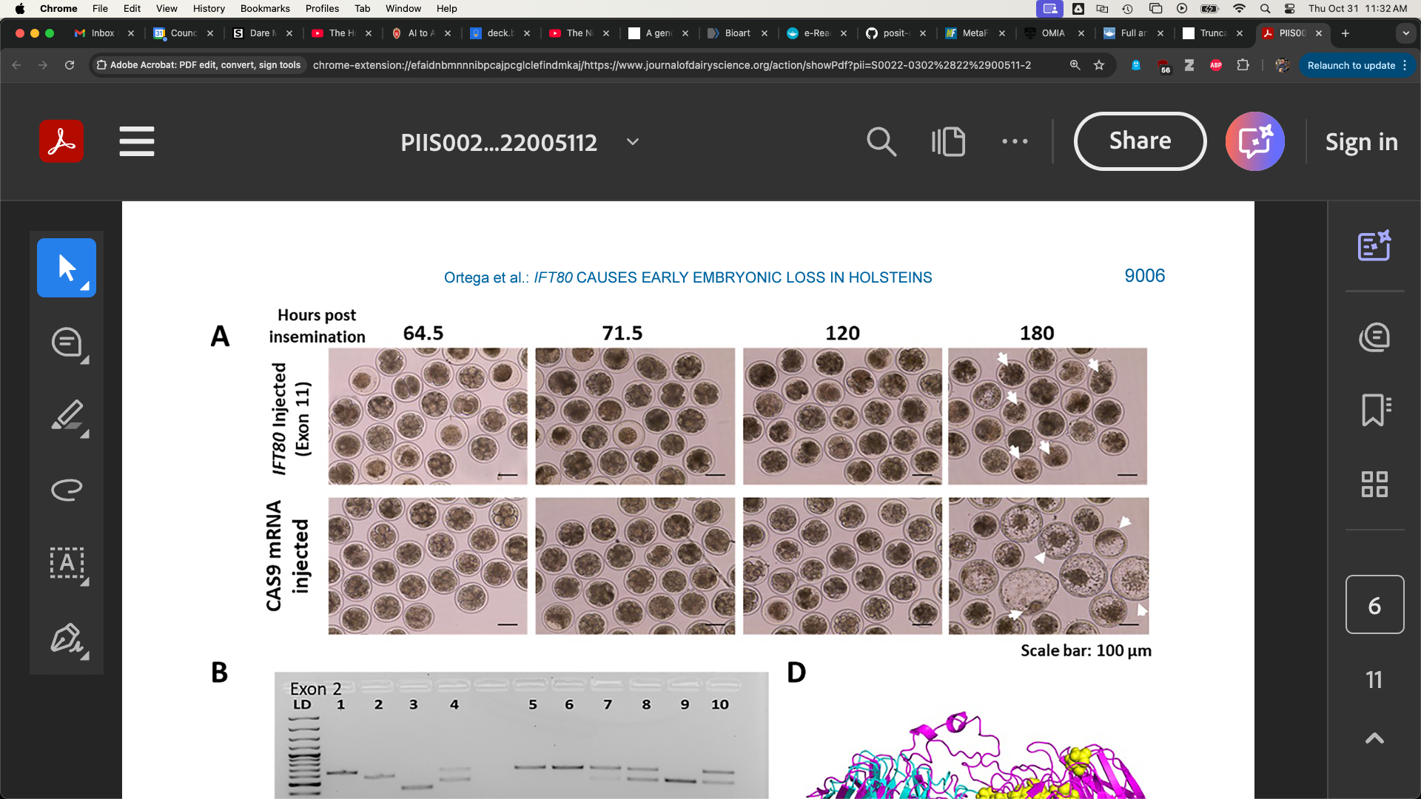
HH2 candidate functionally validated
Control embryos injected with only Cas-9 (left)
A frameshift in IFT80 at 107,172,615 bp (p.Leu381fs) disrupts wnt and hedgehog signaling
A tag SNP is now used to track the causal mutation
Proven sires should be genotyped to confirm concordance
Treatment embryos injected with Cas-9 and IFT80 exon 2 guide RNA (right)

Slide 27
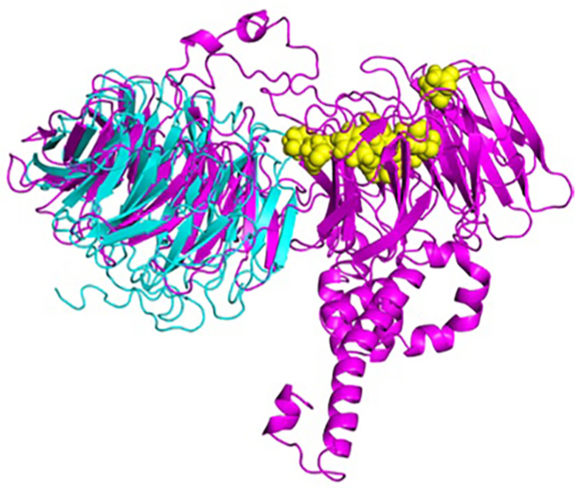
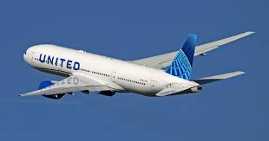
The edited protein is VERY broken
Putative active binding sites (yellow)
385-aa gene-edited protein (blue)
777-aa wild-type protein (magenta)
What a coincidence!

Slide 28
How do we manage the population?

Slide 29
Should carrier bulls be culled? (Old)
Yes, if non-carriers are available and the population is large
Non-carrier bulls are as good as carrier bulls, on average
 | Carriers |  |  |  | Non-carriers
Breed | N | Mean | SD |  | N | Mean | SD | Difference | P value
AY | 16 | 286.43 | 194.67 |  | 53 | 272.41 | 191.69 | 13.02 | 0.407
BS | 30 | 223.10 | 218.39 |  | 59 | 284.19 | 160.36 | -61.09 | 0.087
HO | 550 | 394.08 | 216.77 |  | 1,765 | 479.49 | 213.89 | -85.41 | <0.001
JE | 99 | 340.51 | 149.00 |  | 378 | 338.82 | 153.99 | 1.69 | 0.460
Source: Cole et al. (2016)

Slide 30
Will carrier bulls be culled?
Not in most cases
High-genetic-merit embryos are extremely valuable
Genotyping embryos is difficult and risky
Using cell lines introduces genetic lag and faces regulatory hurdles in the EU
Update – perhaps I’m wrong, anyway
Upperman et al. (2019) found the most profitable breeding strategy was always simultaneous selection and mate allocation rather than indiscriminate selection against carriers.

Slide 31
Should carrier bulls really be culled? (New)
Bulls born 2015 and later, NAAB status code “I”, April 2025 evaluation
 | Carriers |  |  |  | Non-carriers
Breed | N | Mean | SD |  | N | Mean | SD | Difference | % carriers
AY | 32 | 270.84 | 267.58 |  | 56 | 351.95 | 314.80 | -81.11 | 36
BS | 8 | 266.00 | 163.91 |  | 181 | 141.92 | 229.86 | 124.08 | 4
HO | 1,024 | 267.55 | 254.32 |  | 2,253 | 457.62 | 298.00 | -190.07 | 31
JE | 232 | 89.44 | 177.32 |  | 1,214 | 129.49 | 186.84 | -40.05 | 16

Slide 32
Markers can be used for mate selection
Shepherd and Kinghorn (2001) described a look-ahead mate selection scheme using markers.
Li et al. (2006, 2008) showed QTL provide more benefit when used in mate selection rather than in index selection.
Van Eenennaam and Kinghorn (2014) proposed selection against the total number of lethal alleles and recessive lethal genotypes.
Cole (2015) suggested that parent averages can be adjusted to account for genetic load in sequential mate allocation schemes.

Slide 33
How should we manage diversity?
Some ways to avoid inbreeding
Optimal contribution theory
Minimization of progeny inbreeding
Linear programming
Look-ahead mate selection
Selection against lethal alleles
Index selection including Mendelian sampling variance
Genomic selection including dominance
There are many theoretically satisfying ideas nobody uses
Geneticists and AI staff don’t breed cows, farmers do
Many cows are now mated at random to a portfolio of bulls
Everyone’s neighbor should use different bulls

Slide 34
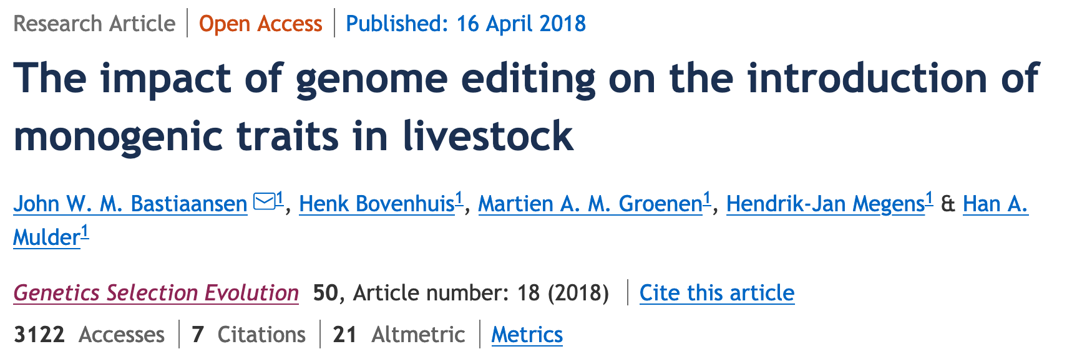
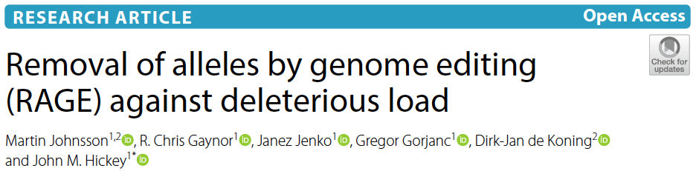
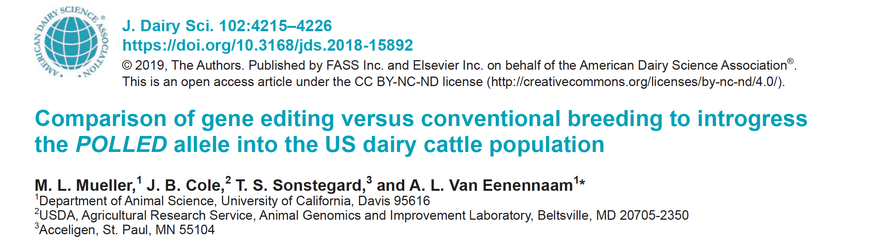
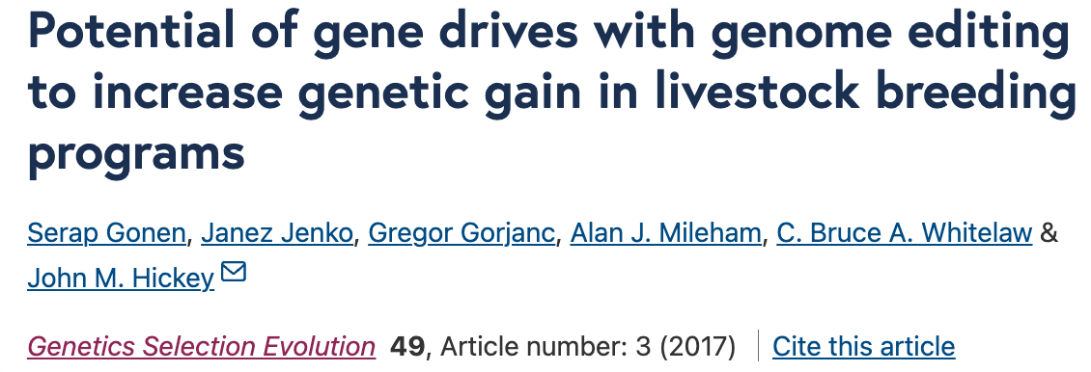
Is gene editing the answer?
Bastiaansen et al. (2019)
Johnsson et al. (2019)
Mueller et al. (2019)
Gonen et al. (2017)

Slide 35
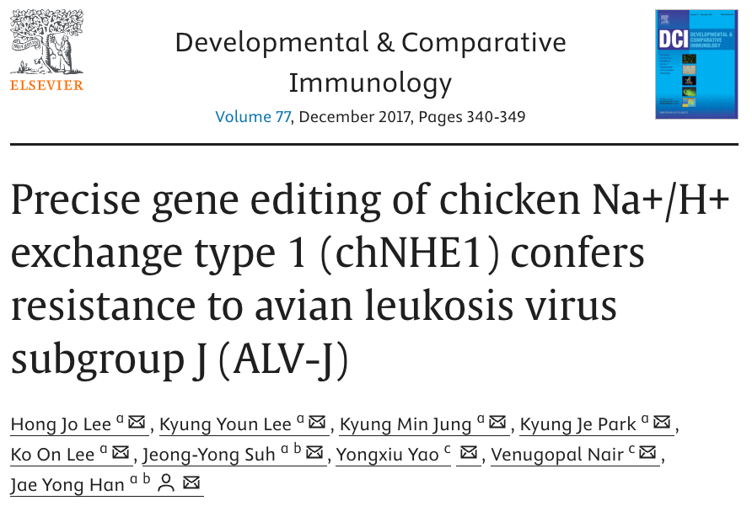
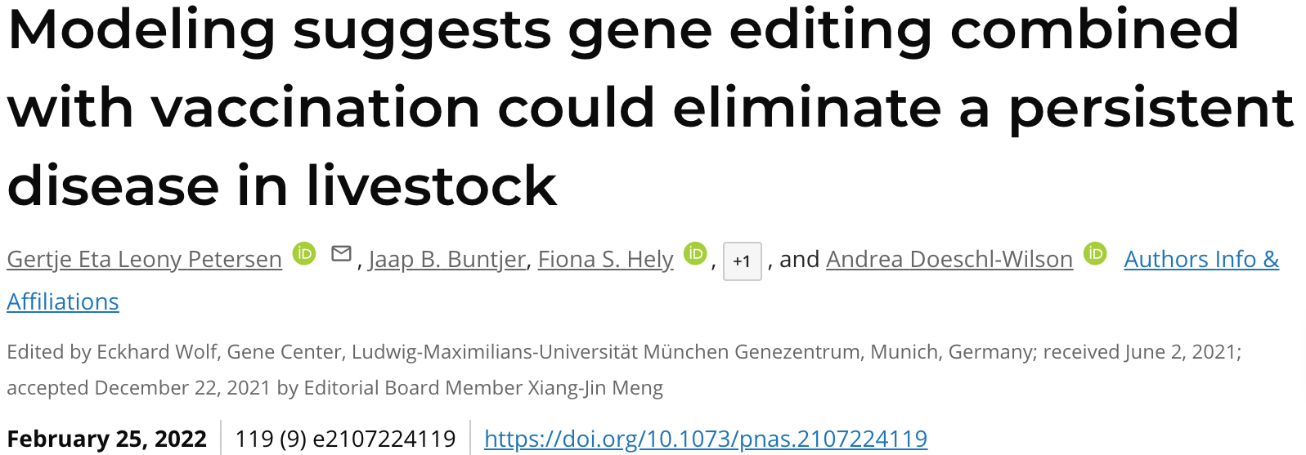
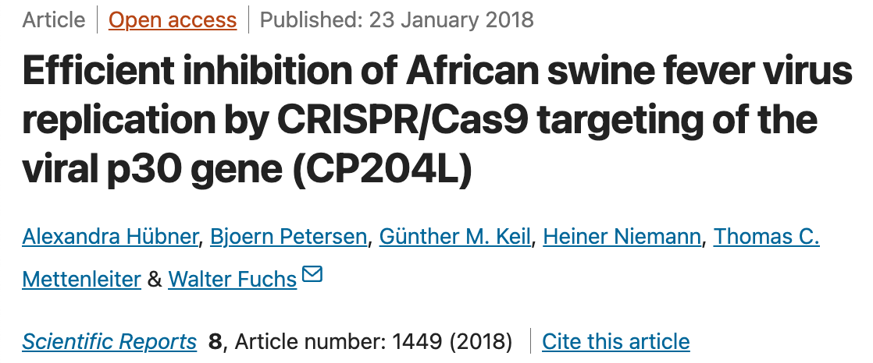
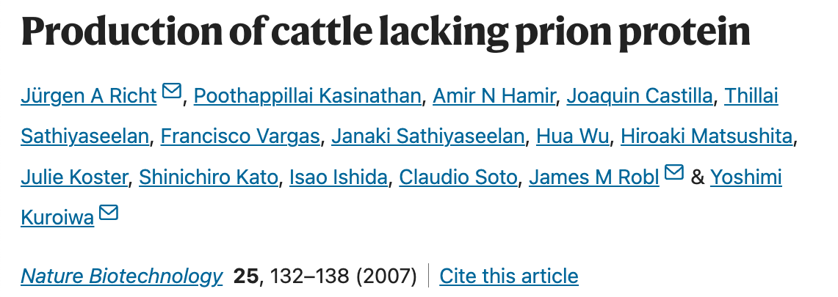
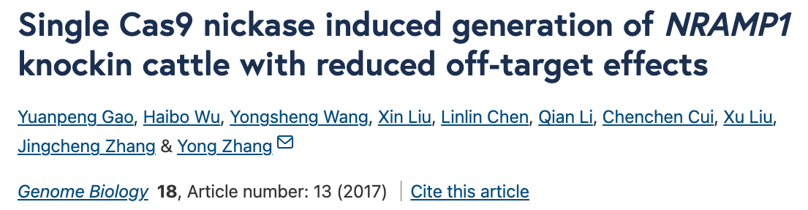
Maybe, eventually?

Slide 36
Inbreeding and recessive loci

Slide 37
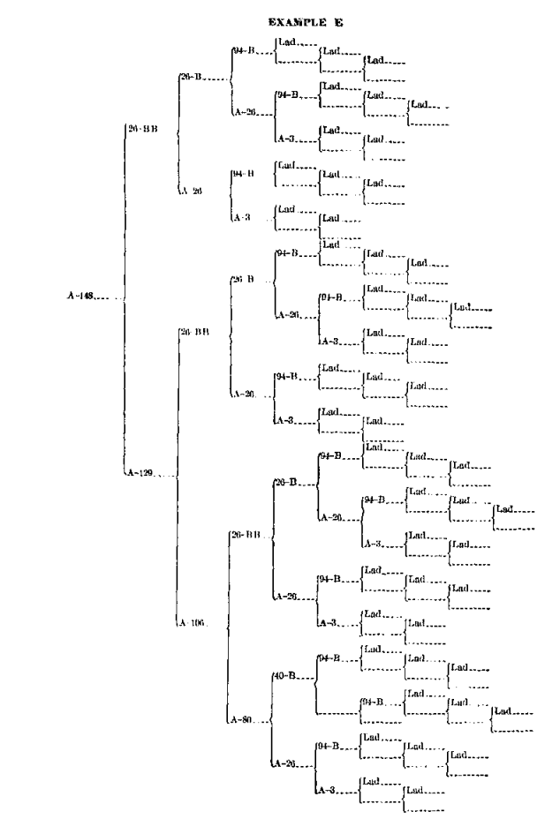
Inbreeding results from the mating of related animals
Cow A-148
f_{P} = 0.646
It’s the proportion of the genome that is identical because it came from the same ancestor
Inbreeding results when related animals are mated to one another
Inbreeding is inevitable in a finite population
It can be managed, but not avoided
Source: Swett et al. (1949)

Slide 38
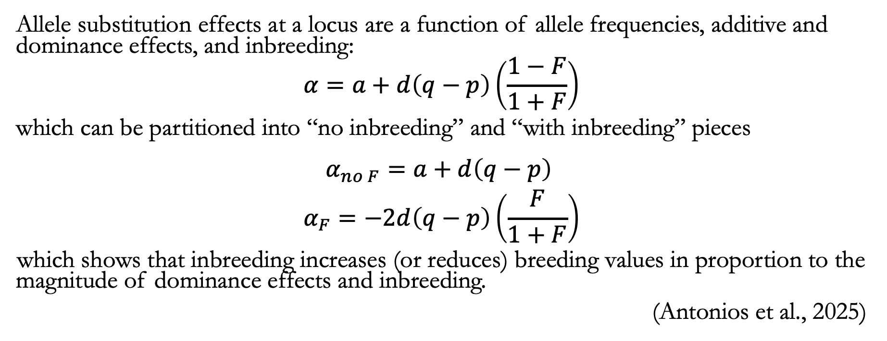
Inbreeding reflects dominance effects
Allele substitution effects at a locus are a function of allele frequencies, additive and dominance effects, and inbreeding:
$$α=a+d\left(q−p\right)\left(\frac{1−F}{1+F}\right)$$
which can be partitioned into “no inbreeding” and “with inbreeding” pieces
$$\begin{matrix}α_{no F}=a+d\left(q−p\right) \\ α_{F}=−2d\left(q−p\right)\left(\frac{F}{1+F}\right)\end{matrix}$$
which shows that inbreeding increases (or reduces) breeding values in proportion to the magnitude of dominance effects and inbreeding.
(Antonios et al., 2025)

Slide 39
Inbreeding often has undesirable effects
Harmful loci increase in frequency and are more likely to be paired-up
e.g., Haplotypes such as HH1
Probably accounts for much of inbreeding depression
Slow inbreeding is more effective at selecting against harmful loci
Undesirable loci travel along with desirable loci if they’re close together (“hitchhiking”)

Slide 40

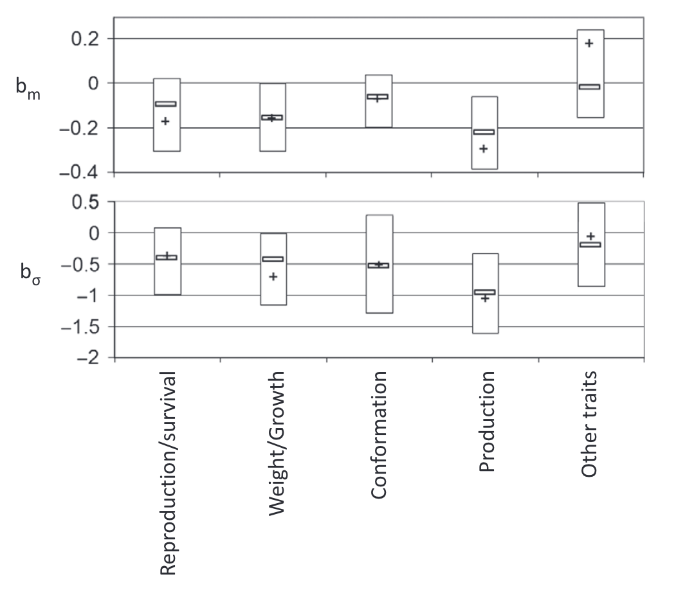
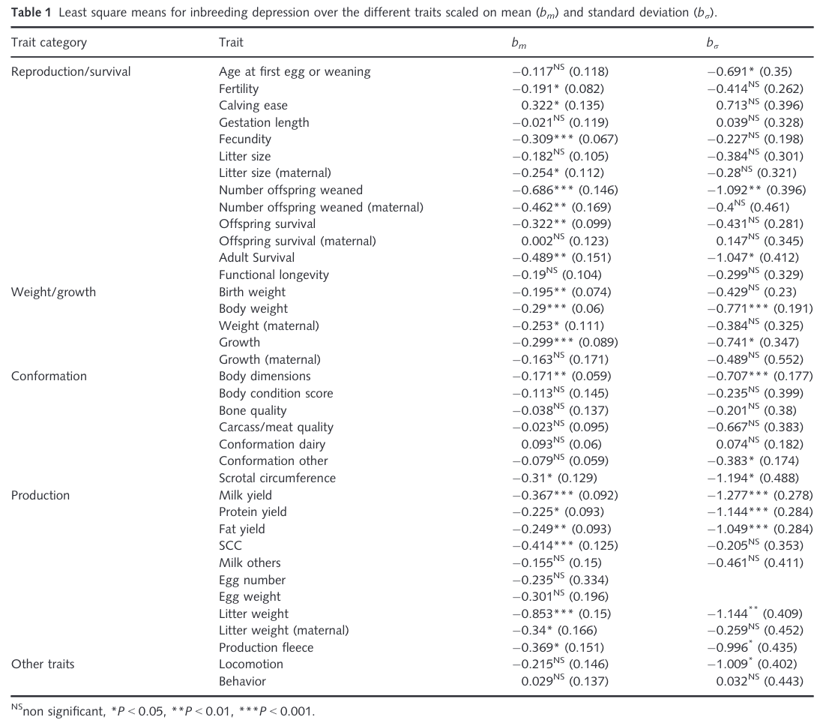
Genetic load affects performance
Source: Leroy (2014)

Slide 41
What causes inbreeding depression?
Most lethal inbreeding load is probably mutational in origin (Simmons & Crow, 1977)
Mutation explains ~30% of effects on net fitness, and ~60% of load on fitness (Charlesworth & Hughes, 1999)
Many sublethal recessives with small effects may explain other inbreeding effects (Charlesworth & Willis, 2009)
Some classes of functional annotation are disproportionally responsible for inbreeding depression in Jersey cattle (Xu et al., in preparation)

Slide 42
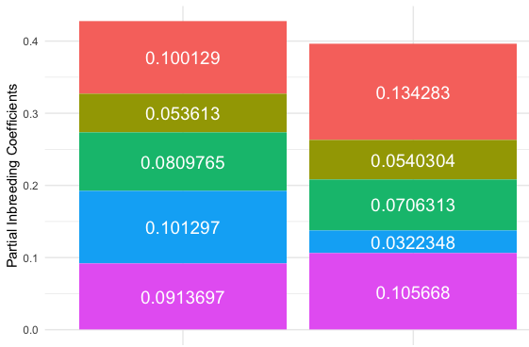
Causes of inbreeding depression vary among animals
Coding regions
Highly-conserved regions within a multiple sequence alignment (GERP)
Intronic regions
Promoter regions
Untranslated regions

Slide 43
Discussion

Slide 44
Are we concerned about the wrong thing?
“Selection, however - in marked contrast to its effectiveness in changing average merit - is a very feeble tool for changing homozygosity, except under the very simplest genetic situations…” (Lush, 1945)
“When the pure breeds finally reach equilibrium between the production of heterozygosis by mutations and the loss of heterozygosis because the effective number of animals in the breed is small, it is possible that the pure breed may support only a few scores of unfixed loci.” (Lush, 1945)

Slide 45
This not a uniquely dairy problem!
Beef cattle
1 new lethal and 2 semi-lethal haplotypes(Jenko et al. 2019)
Poultry
Wingless-2 syndrome (Youngworth and Delany, 2019)
Pigs
5 recessive lethal haplotypes in 2 commercial populations (Derks et al., 2019)
Sheep
11 homozygous haplotypes identified in Lacaune dairy sheep (Braiek et al., 2021)

Slide 46
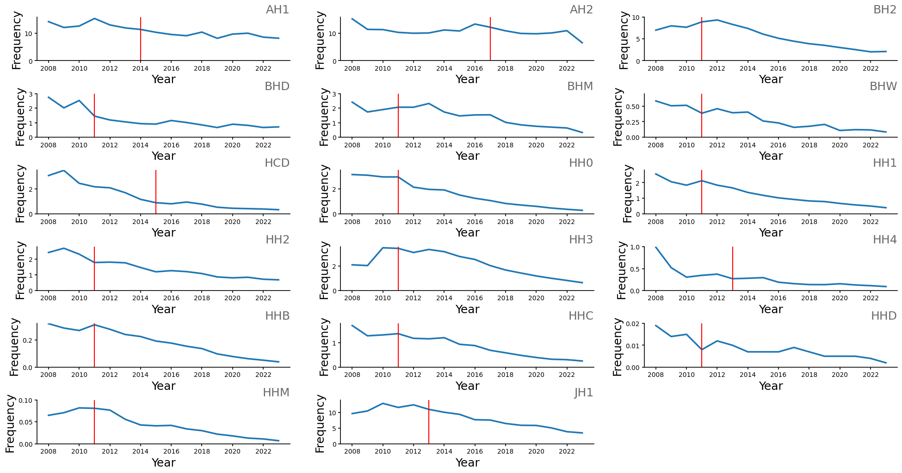
Recessives with favorable trends
Cole et al. (2025)

Slide 47
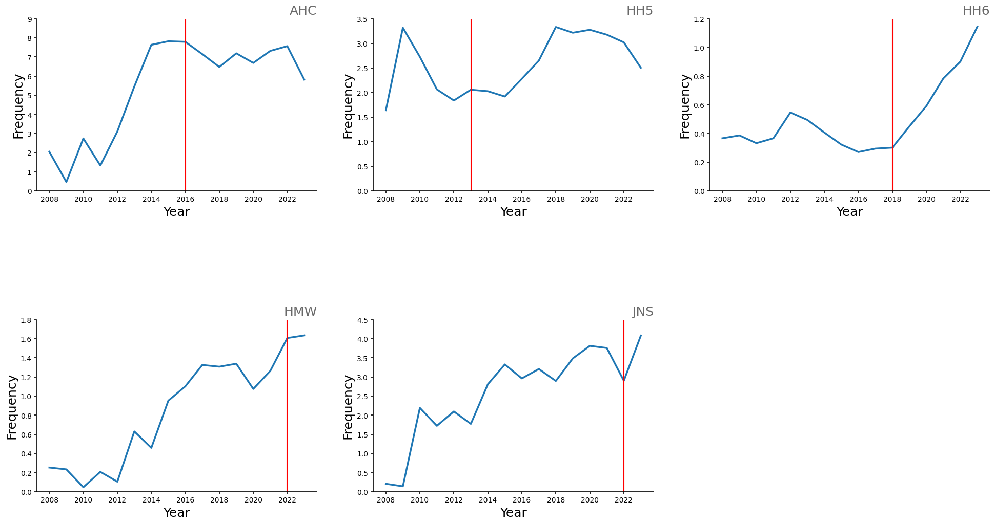
Recessives with unfavorable trends
Cole et al. (2025)

Slide 48
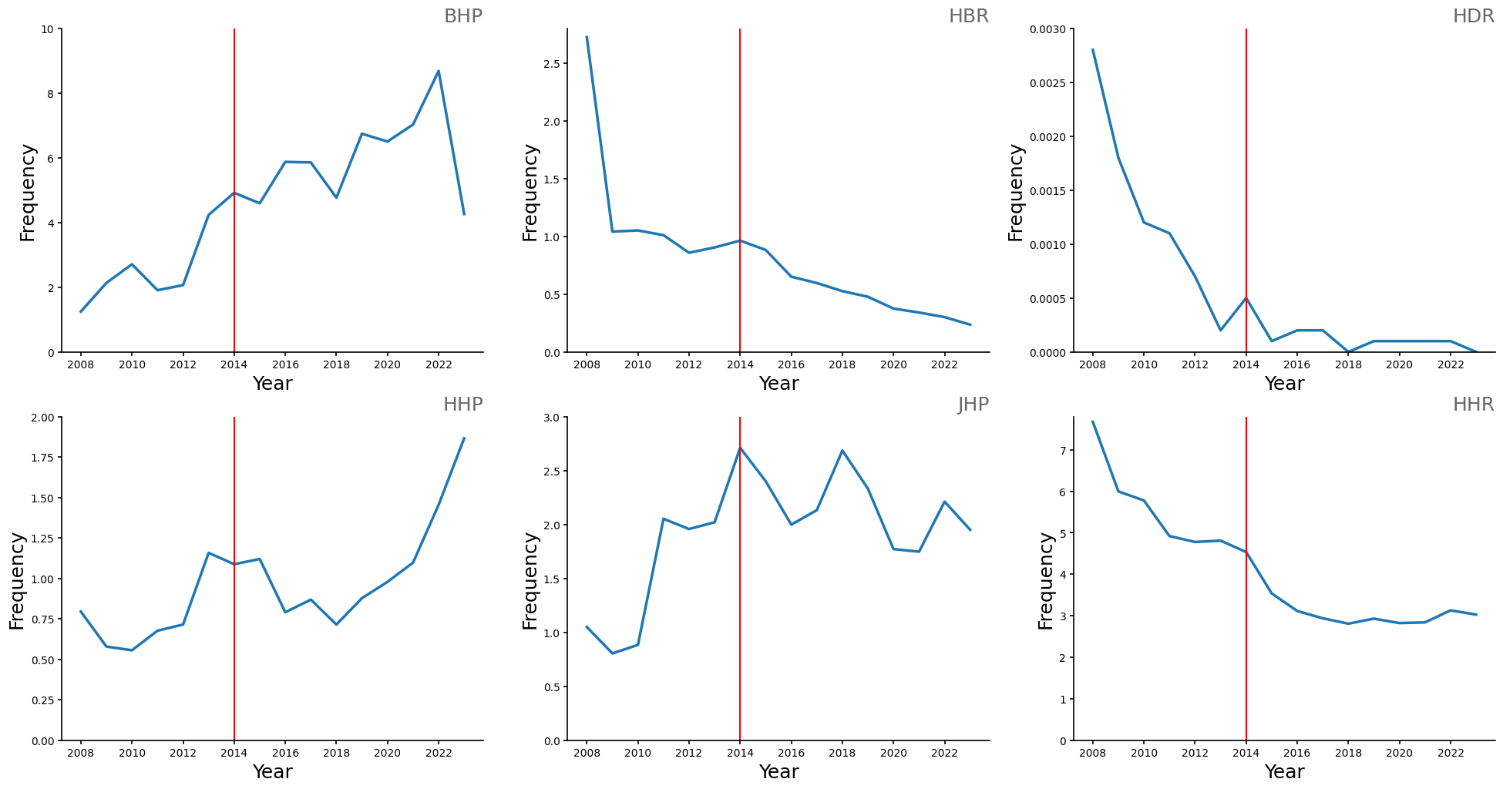
Trends for physical characteristics
Cole et al. (2025)

Slide 49
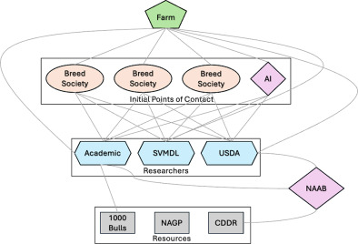
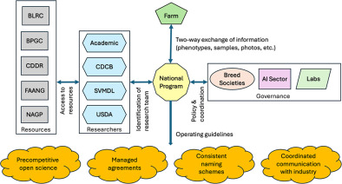
Population management isn’t easy
Current Situation
Proposed Future Structure
Cole et al. (2025, in press)

Slide 50
Conclusions
Mendelian defects cause economic losses to dairy farmers
As technology improves, we’re identifying more genetic defects
Knockout embryos allow quick, cost-effective functional validation of candidate mutations
Gene editing might one day be useful for removing harmful alleles from populations
Population management is very challenging in a loosely coupled system

Slide 51
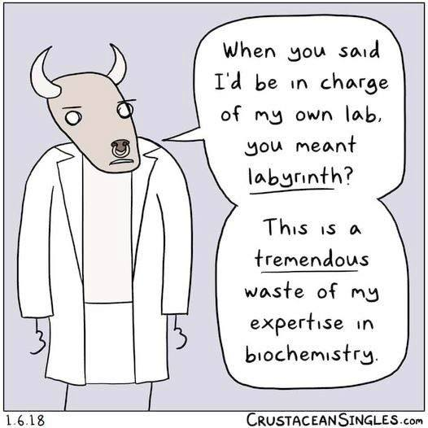
Questions?
Thank you for your attention!
john.cole@uscdcb.com

